Slide 1
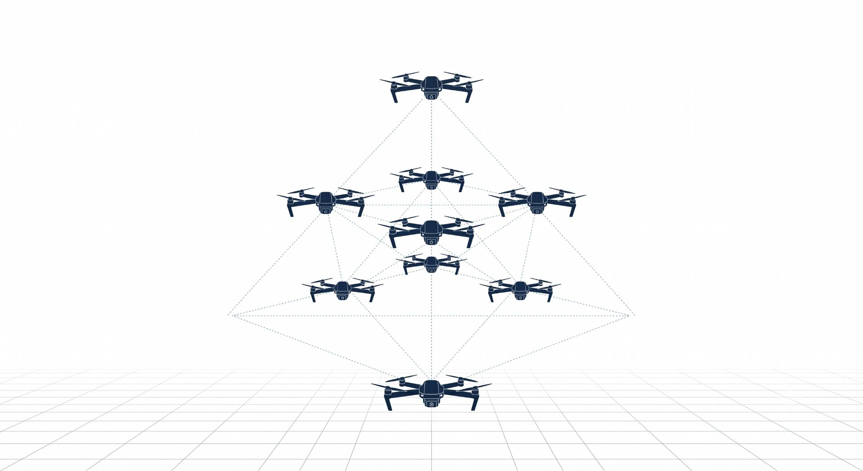

Dynamic Target Assignment and Collision Avoidance for Multi-UAV Coordination in 3D using MARL
Ayesha Khalil, CIIT/SP25-RCS-009/ATD
Supervisor: Dr. Faisal Rehman Co-supervisor: Dr. Ehzaz Mustafa

Slide 2
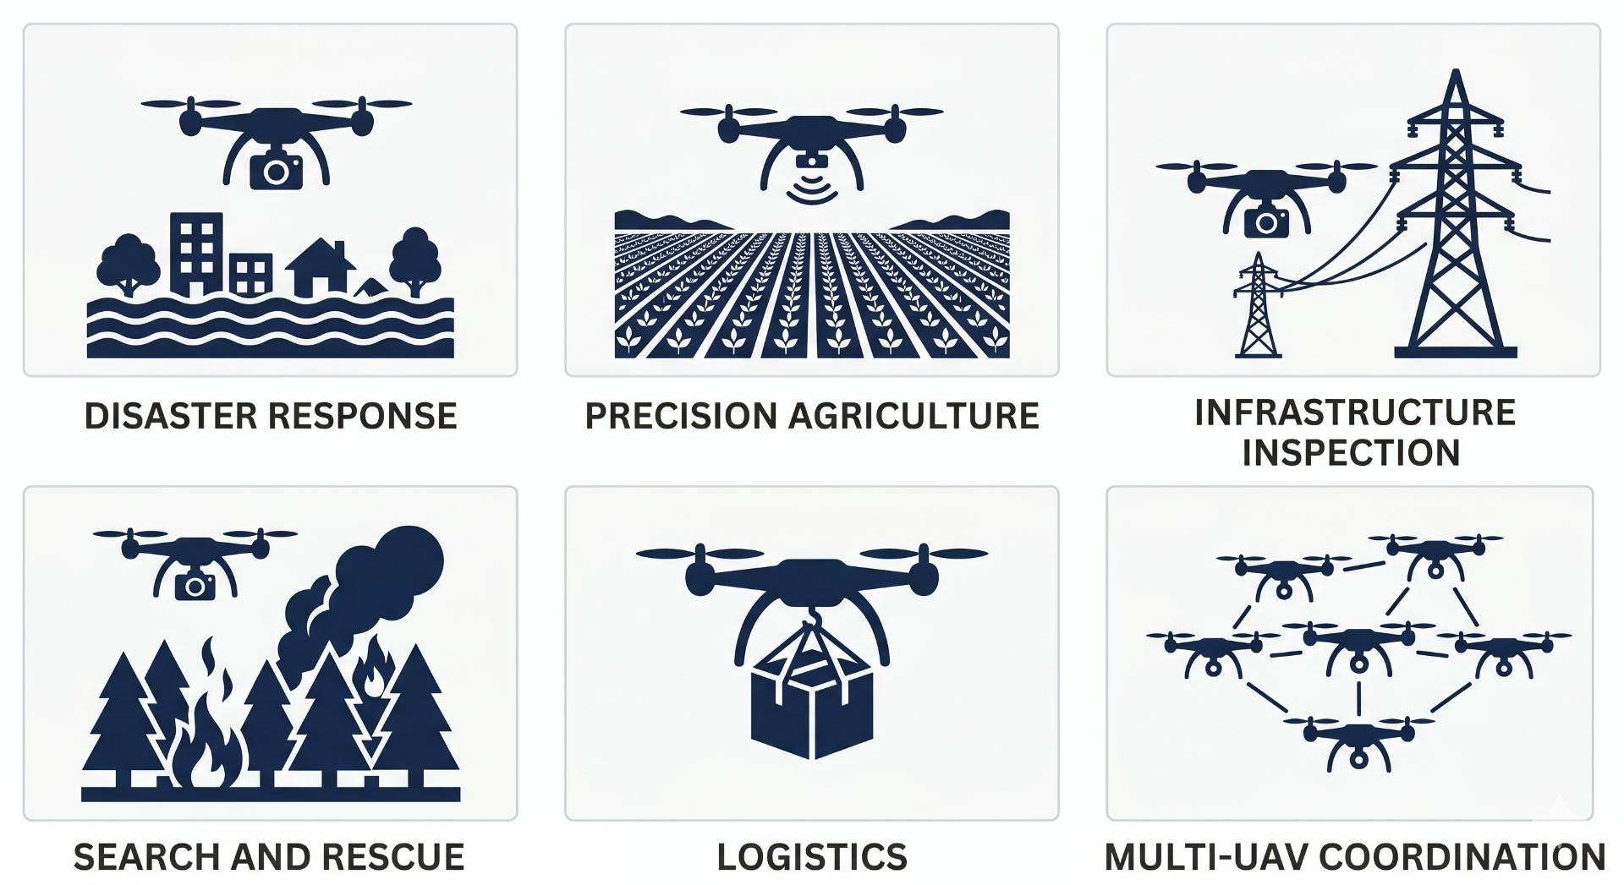
Introduction:
From military applications to civilian and industrial use
A single drone is insufficient
Real tasks demand multi-UAV teams
Hardware advances alone cannot solve coordination it requires intelligent algorithm

Slide 3
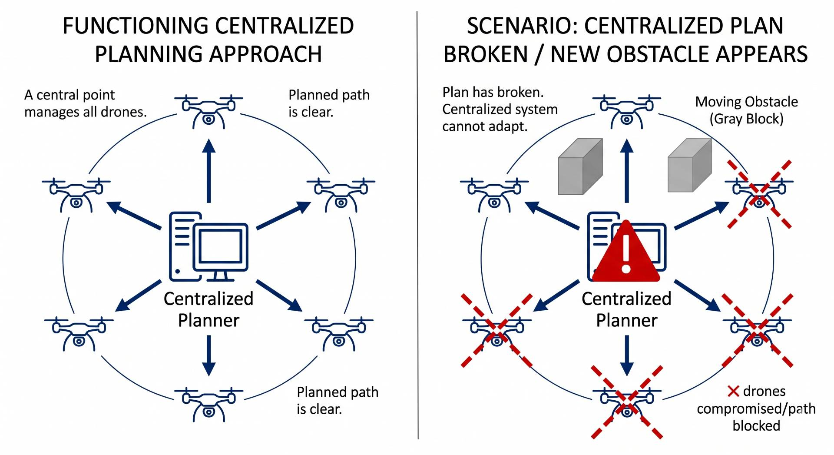
Introduction cont… Multi-UAV Coordination
Classical Approach Centralized Planner:
Computes globally optimal solution before deployment
❌ Fails when targets move or obstacles appear mid-mission
❌ Recomputing in real time is computationally intractable
Learning-Based Approach:
Drones learn cooperative behavior through trial and error

Slide 4
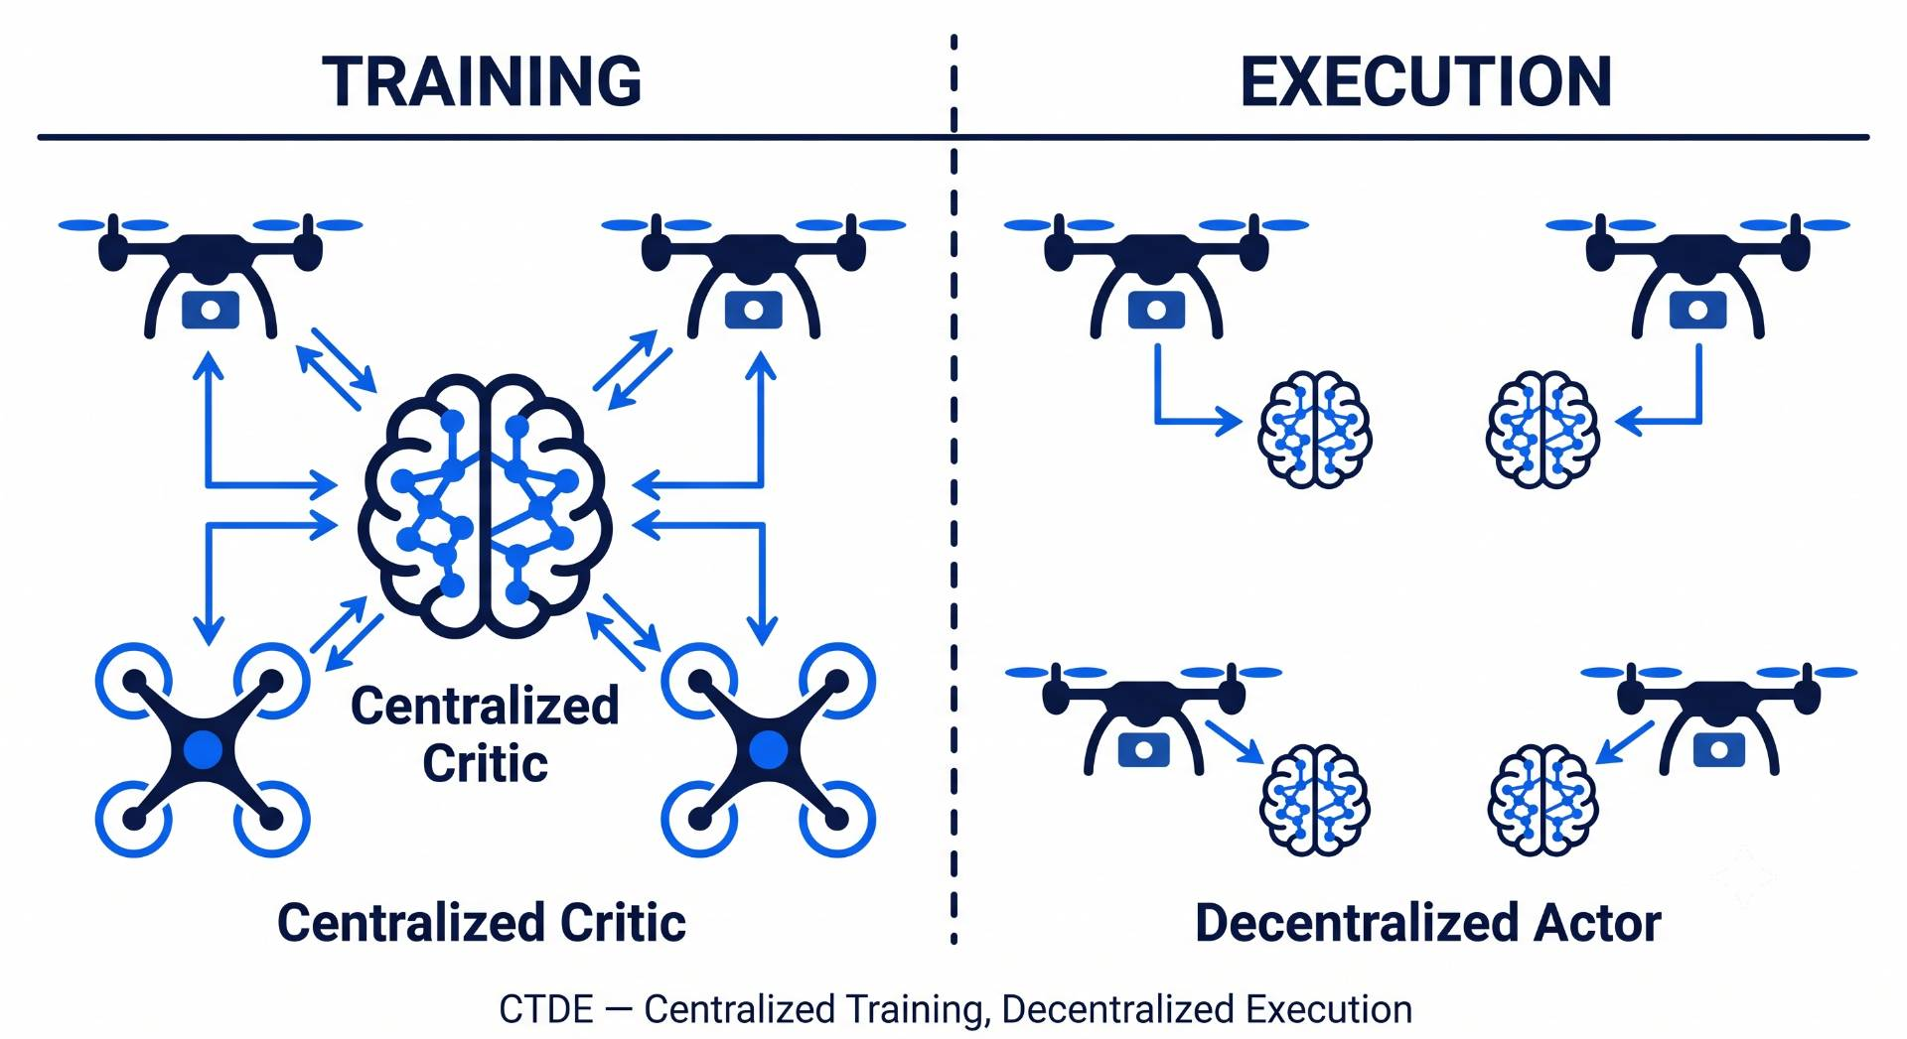
Introduction cont… DRL & MARL
DRL: Agent interacts with environment → receives rewards → improves policy through experience
MARL: Extends DRL to teams
CTDE Architecture: Centralized Training, Decentralized Execution
MAPPO (Multi-Agent PPO): proven stable, widely used baseline for cooperative UAV tasks

Slide 5
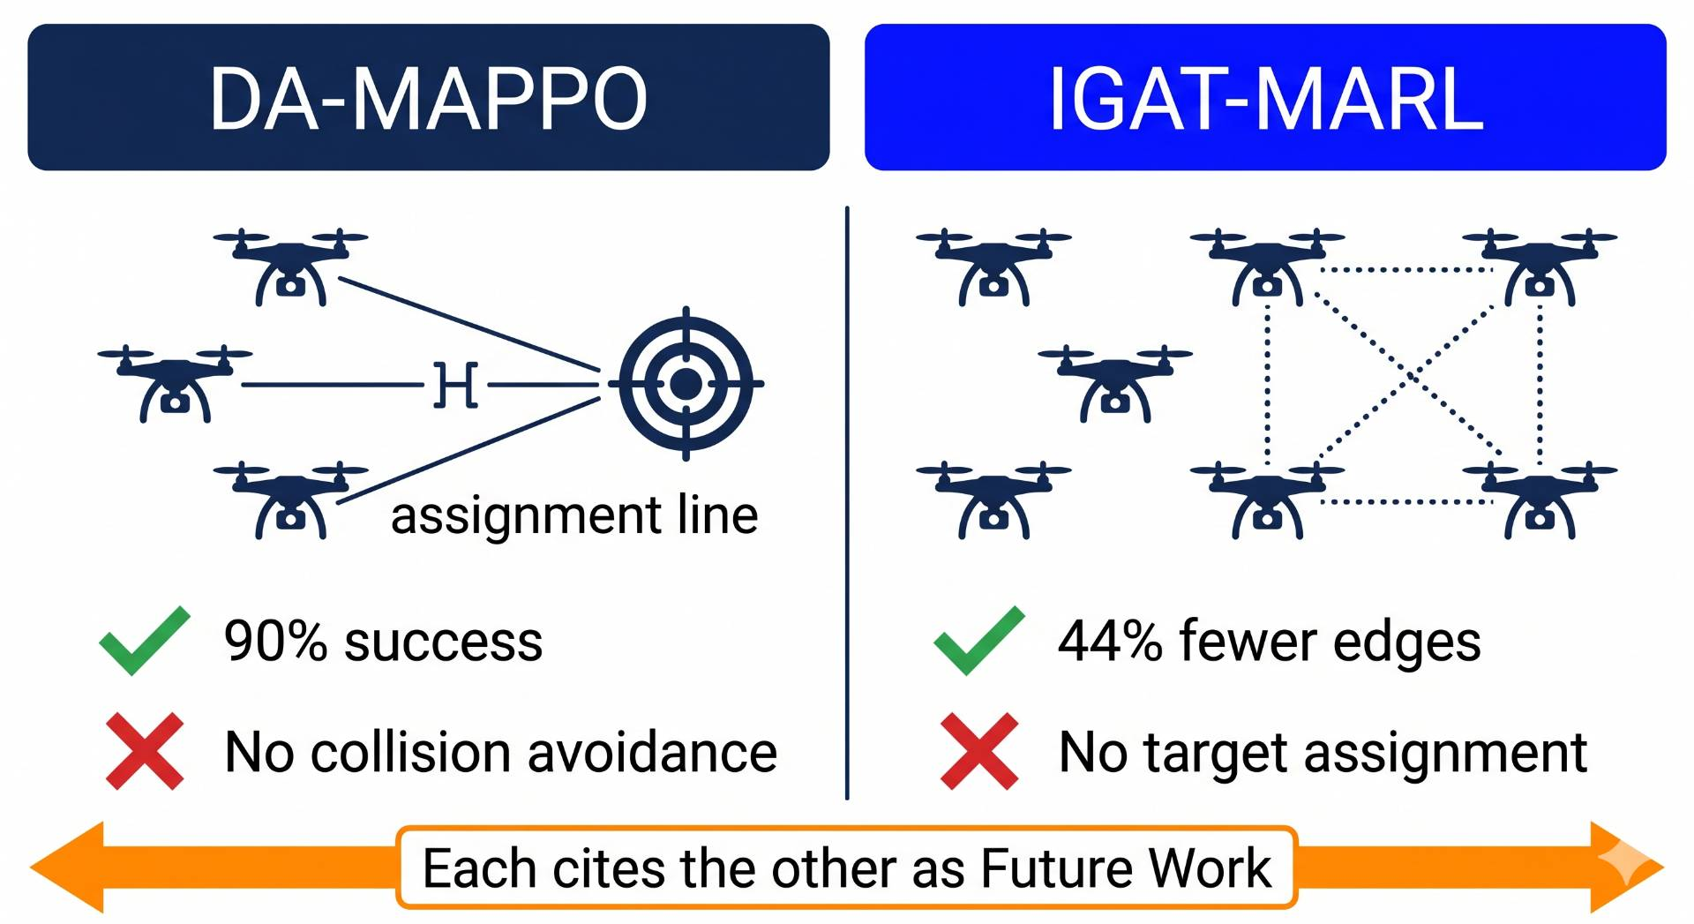
Motivation:
DA-MAPPO achieves 90–99% mission success using real-time Hungarian assignment but has no collision avoidance
IGAT-MARL reduces interaction edges by 44% using a conflict-aware graph but has no target assignment
DA-MAPPO ablation: removing assignment information causes success to drop from 90% → 0%
Both papers explicitly name the other's problem as their own future work this research is that future work
This research proposes a unified MAPPO-based framework that integrates real-time target assignment and conflict-aware collision avoidance in a single policy for 5–8 drones in a 3D environment.

Slide 6
Related Work:
Authors | Contribution | Methodology | Dataset/Sample | Strength | Limitation
Govinda, Brik & Harous (2025) | Systematic review of DRL for UAV, robotics, transportation | Literature survey across published DRL studies | Published papers (no primary data) | Identifies lack of unified frameworks as the key open gap | Survey only — no new algorithm proposed
Tang, Liang & Li (2024) | Single UAV navigation in dynamic obstacle environments | Improved D3QN + Prioritized Experience Replay + heuristic action bias | Custom 2D sim, single UAV, moving obstacles | 95% success rate, outperforms A* and RRT | Single drone only, 2D, discrete actions
Kong, Zhou, Li & Wang (2024) | Joint target assignment + path planning for multi-UAV | TANet-TD3 + Hungarian algorithm supervision + POMDP | Custom 2D sim, 5 UAVs, moving targets | First paper combining assignment + path planning | 2D only, no inter-drone collision avoidance
Jarray, Zaghbani & Bouallègue (2025) | UAV path planning in large-scale 3D environments | DQN + 3D CNN + dynamic reward formula | Custom 3D sim, 25 km² area, 4 obstacle densities | 98% success in 3D, beats PSO and GWO | Single drone, static obstacles only

Slide 7
Related Work Cont…
Authors | Contribution | Methodology | Dataset/Sample | Strength | Limitation
Rezaee et al. (2026) — IGAT-MARL | Collision avoidance using sparse conflict-aware interaction graph | Conflict-driven sparse graph + Improved GAT + curriculum | BlueSky sim, 3–10 fixed-wing UAVs, conflict-guaranteed episodes | 44% fewer edges, 17% higher reward, 10% fewer dangerous events | No target assignment — drones have no goals
Sheng et al. (2026) — DA-MAPPO | Real-time dynamic target assignment embedded in drone observation | Hungarian algorithm at every step + MAPPO + 4-tier reward + curriculum | Custom sim, 3 UAVs, 3 dynamic targets, 30–50 static obstacles | 90–99% mission success, robust to 50% packet loss and 6-step delay | 2D only, 3 drones only, no inter-drone collision avoidance
Zhang et al. (2025) | Large-scale UAV swarm navigation with mean-field RL | Mean-field DDPG + multi-head attention + CTDE | Custom 2D sim, 20–120 UAVs, static obstacles | >90% success at 120 drones where baselines collapse | 2D only, static obstacles, homogeneous drones
Xu et al. (2026) — MRLMN | UAV multi-hop networking with LLM-guided MARL | GPT-4o knowledge distillation + IPPO + role-based reward decomposition | Custom sim, 12–24 UAVs, 150 ground users | 52% higher data rate, 27% more user coverage | 2D only, GPT-4o dependency, no energy modeling

Slide 8
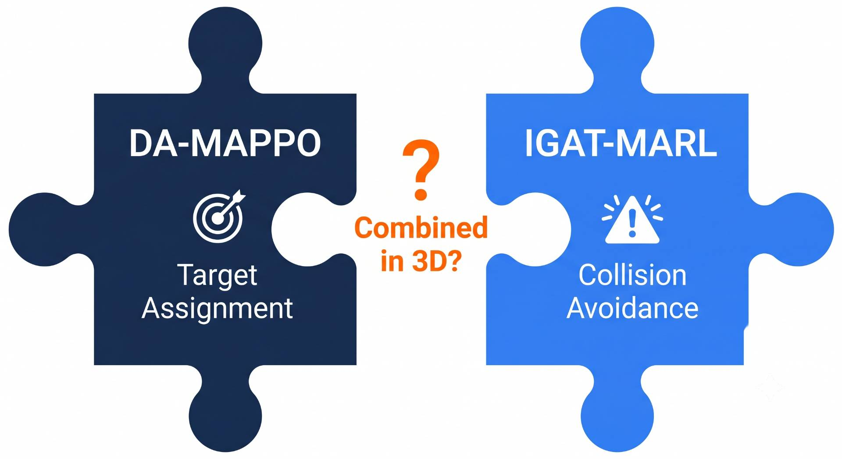
Gap in existing work:
Researchers studying target assignment built methods without collision avoidance
Researchers studying collision avoidance built methods without any goal/target structure
All existing work tested in 2D environments only
Result: capable but partial solutions each solves one piece, ignores the rest
The two most advanced recent papers each explicitly cite the other's problem as their own next step

Slide 9
Problem Statement:
Existing approaches to multi-UAV coordination treat dynamic target assignment and collision avoidance as separate problems, each developed and validated independently in two-dimensional environments. When both mechanisms operate simultaneously in three-dimensional space, they generate competing navigation signals the assignment directs each drone toward its target without awareness of active collision conflicts, while the collision avoidance module forces course corrections without awareness of current assignments, a tension that becomes structurally significant when vertical flight paths are introduced. No existing framework has addressed this interference jointly in three-dimensional space, leaving it unknown whether a unified policy can sustain both assignment optimality and collision safety simultaneously, or whether the mechanisms degrade each other when combined.

Slide 10
Research Objective
Design a unified observation vector encoding both the Hungarian-algorithm assignment state and the conflict-aware neighborhood for each drone in a 3D MAPPO policy
Test scalability across swarm sizes of 3, 5, and 8 drones determine if performance degrades as simultaneous assignment-conflict interactions increase
Find the failure boundary identify swarm size, obstacle density, and target speed conditions where the unified policy fails, and characterize the failure mode

Slide 11
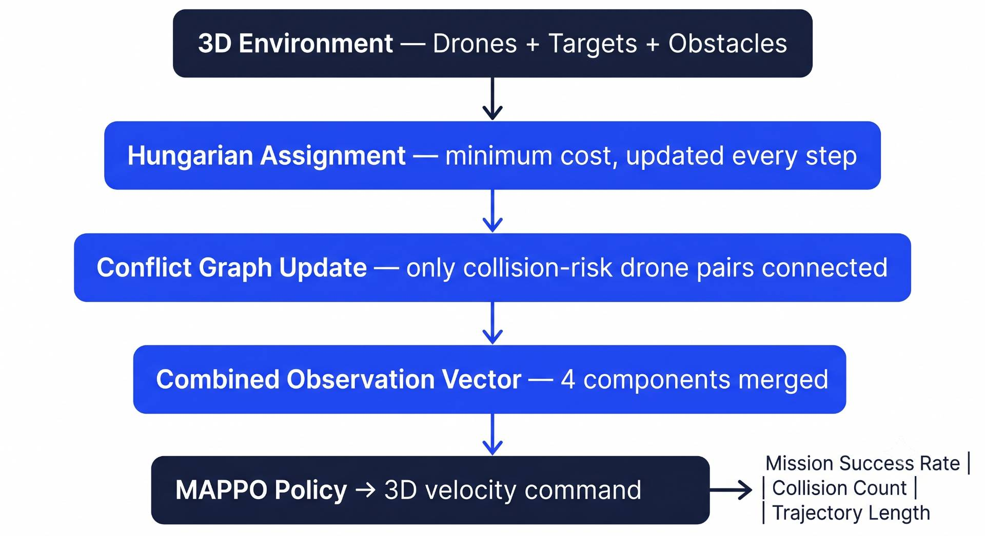
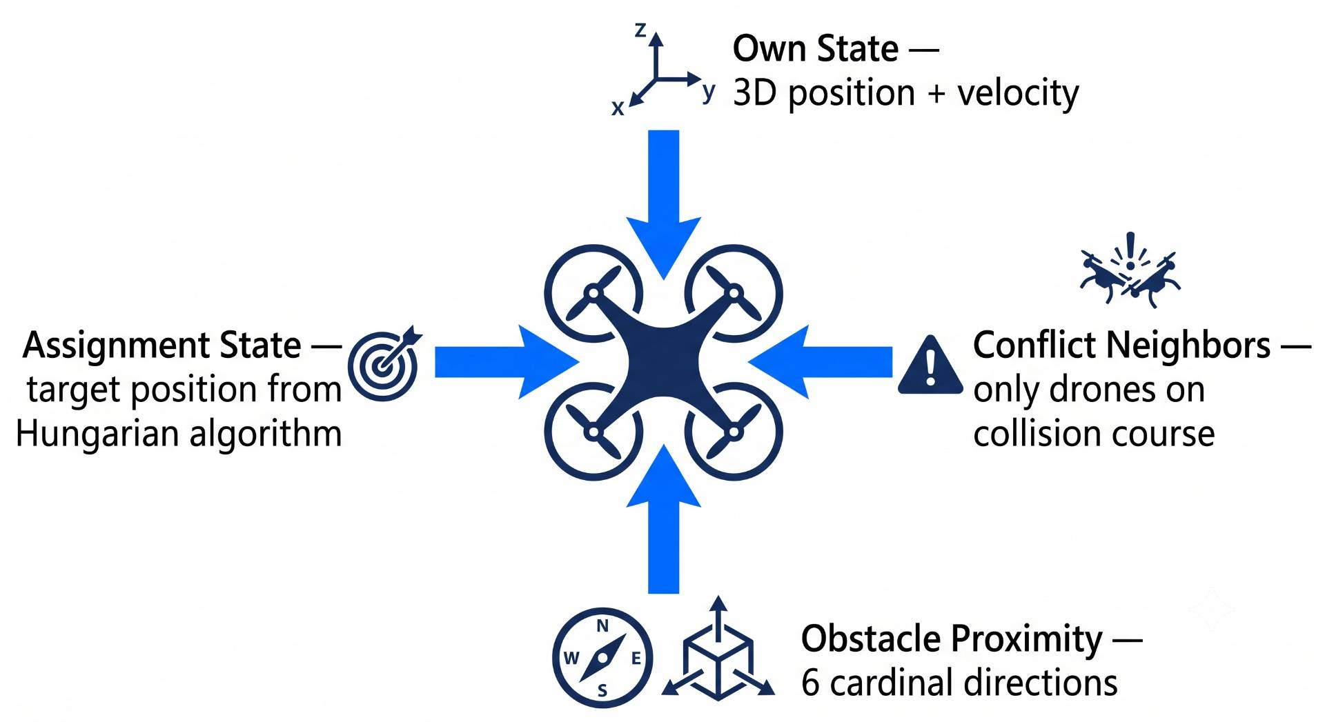
Proposed Methodology:
Each drone's observation includes 4 components:
# | Component | Source
1 | Own 3D position + velocity | Onboard sensors
2 | Current target position | Hungarian algorithm (updated every step)
3 | Conflict neighbor positions + velocities | Conflict graph (sparse, collision-risk pairs only)
4 | Obstacle proximity (6 directions) | Proximity sensors ±x ±y ±z

Slide 12
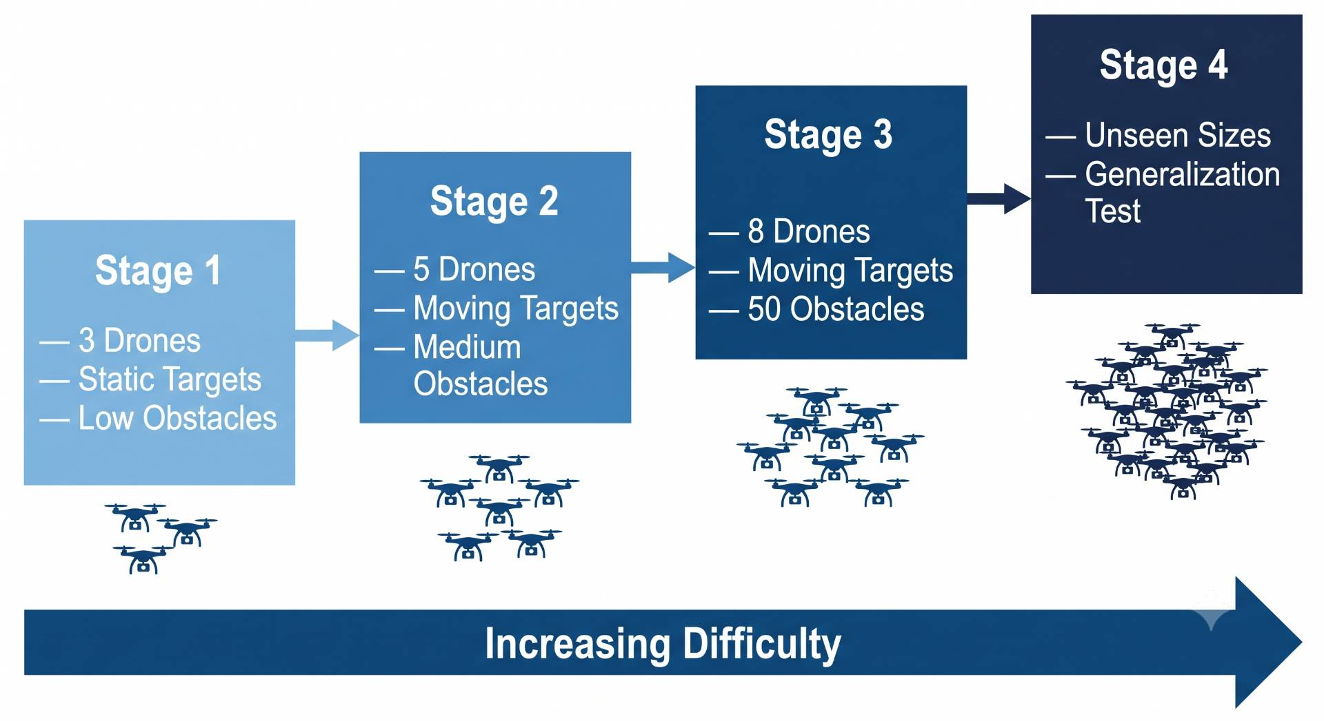
Training Strategy:
Stage | Drones | Obstacles | Goal
1 | 3 | Low | Replicate DA-MAPPO baseline in 3D
2 | 5 | Medium | Assignment + avoidance together
3 | 8 | 50 (high) | Full challenge
4 | Unseen sizes | Various | Generalization

Slide 13
References:
S. Govinda, B. Brik, and S. Harous, "A survey on deep reinforcement learning applications in autonomous systems," IEEE Trans. Intell. Transp. Syst., vol. 26, no. 7, 2025.
J. Tang, Y. Liang, and K. Li, "Dynamic scene path planning of UAVs based on deep reinforcement learning," Drones, vol. 8, no. 2, p. 60, 2024.
X. Kong, Y. Zhou, Z. Li, and S. Wang, "Multi-UAV simultaneous target assignment and path planning based on deep reinforcement learning in dynamic multiple obstacles environments," Front.Neurorobot., vol. 17, p. 1302898, 2024.
R. Jarray, I. Zaghbani, and S. Bouallègue, "Dynamic reward-based deep reinforcement learning algorithm for UAV path planning in large-scale environments," Procedia Comput. Sci., vol.270, pp. 692–702, 2025.
M. R. Rezaee, N. A. W. A. Hamid, M. Hussin, and Z. A. Zukarnain, "Efficient multi-agent deep reinforcement learning algorithm for multi-UAV collision avoidance," Appl. Soft Comput., vol.197, p. 115145, 2026.
Y. Sheng, X. Xie, H. Liu, and J. Li, "Dynamic target assignment and cooperative decision-making for UAV swarms based on multi-agent reinforcement learning," IEEE Internet Things J., doi:10.1109/JIOT.2026.3686066, 2026.
Y. Zhang et al., "Large-scale UAV swarm path planning based on mean-field reinforcement learning," Chin. J. Aeronaut., vol. 38, no. 9, p. 103484, 2025.
Y. Xu et al., "Scalable UAV multi-hop networking via multi-agent reinforcement learning with large language models," arXiv:2505.08448, 2026.

Slide 14
Thank you!

